Slide 1
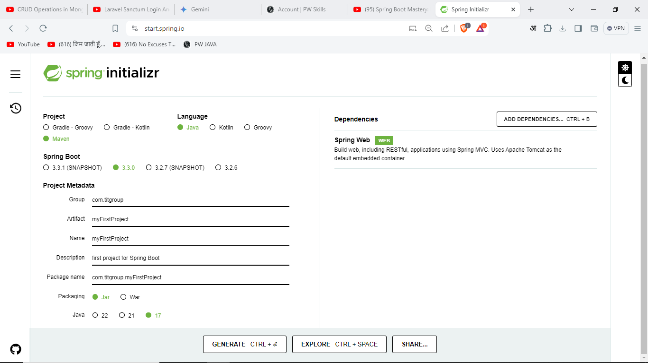

Slide 2
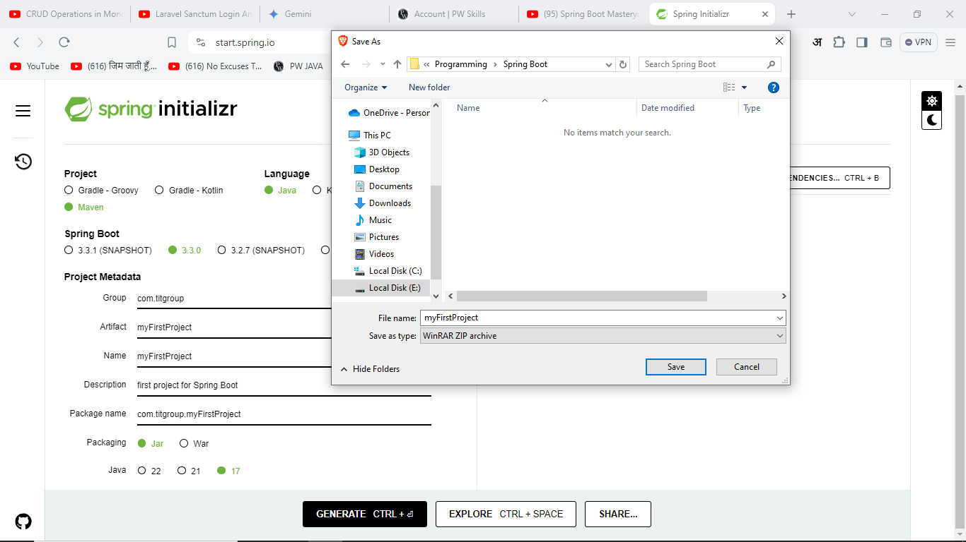

Slide 3
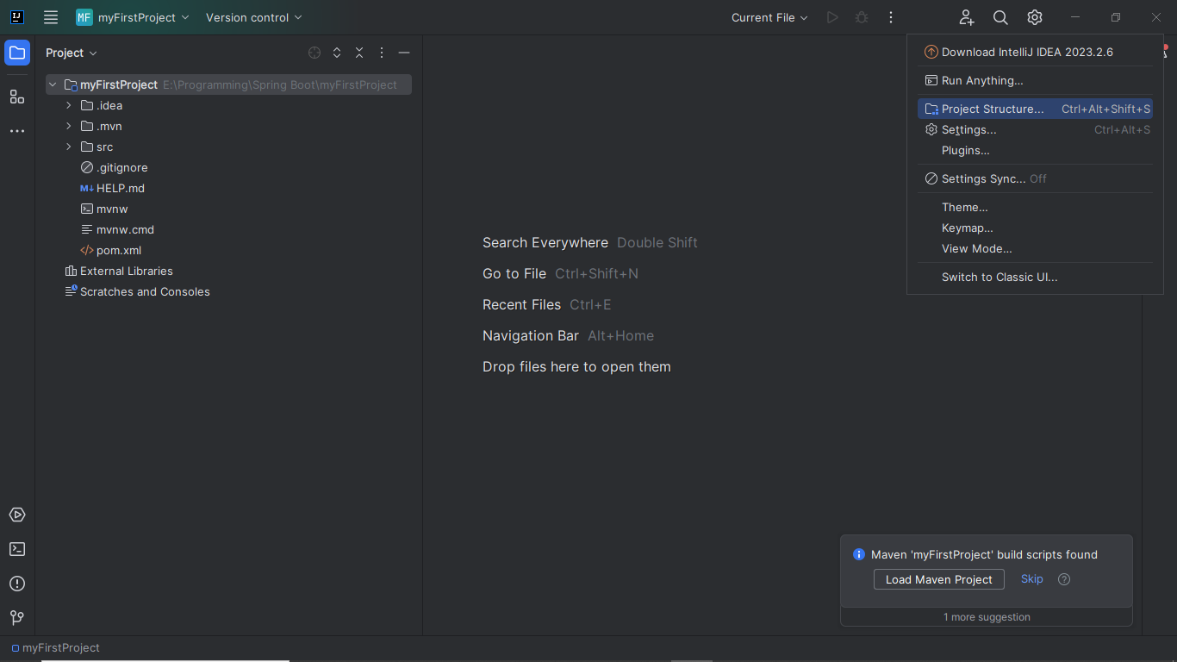

Slide 4
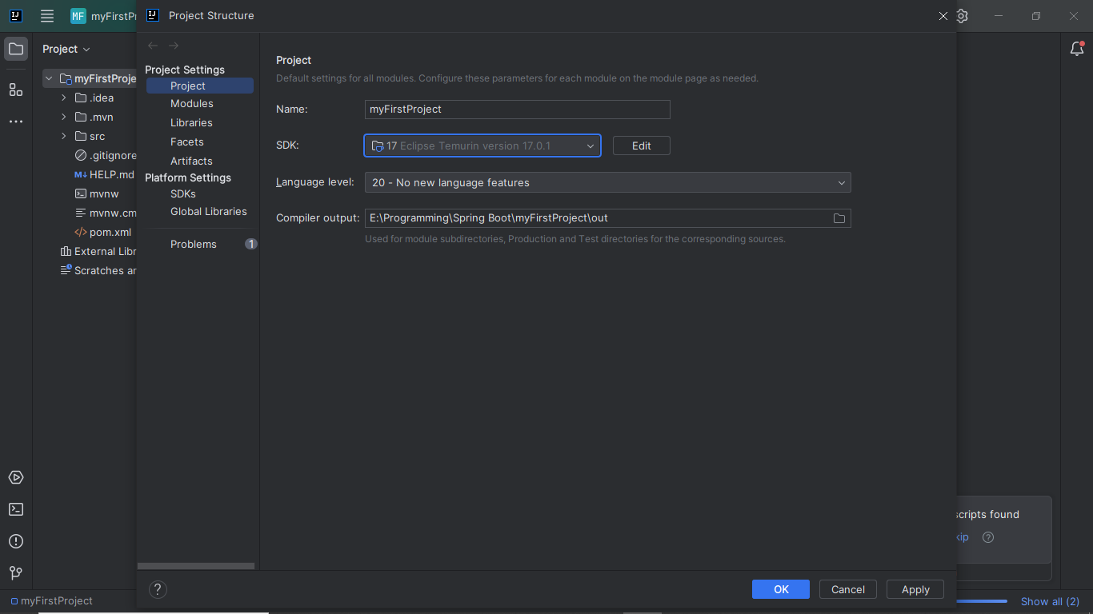

Slide 5
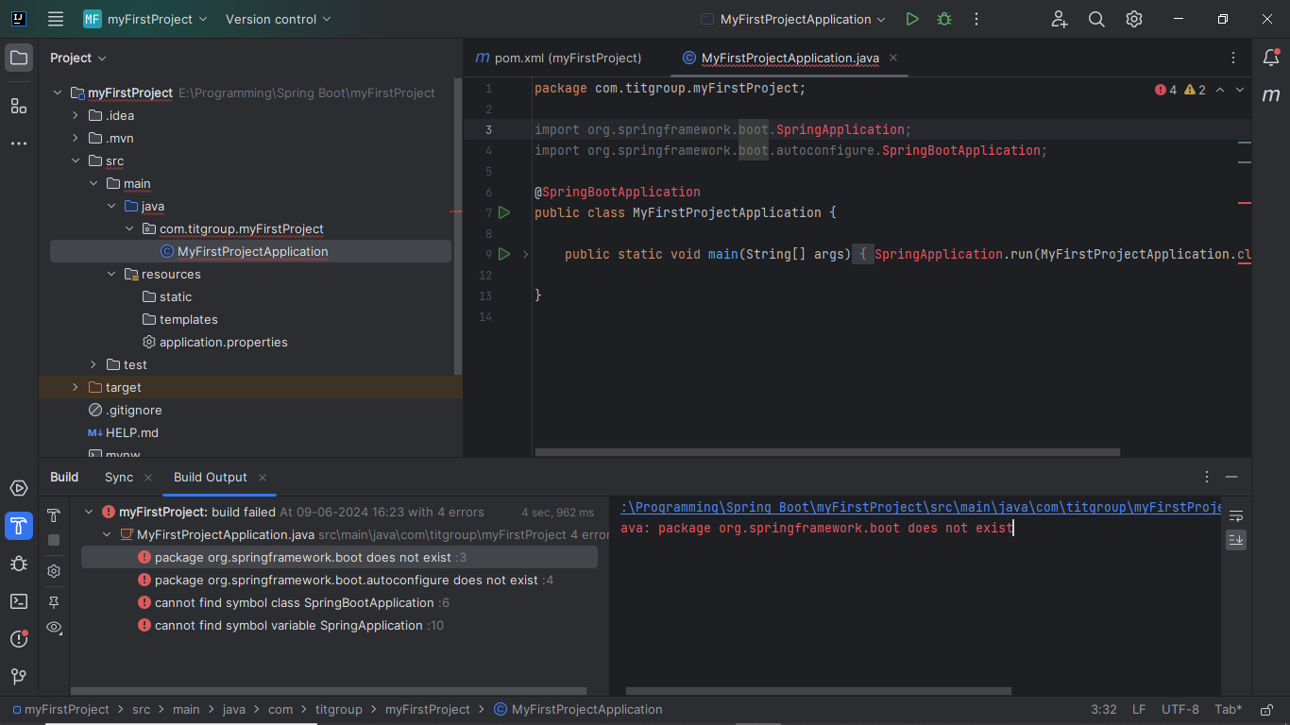

Slide 6
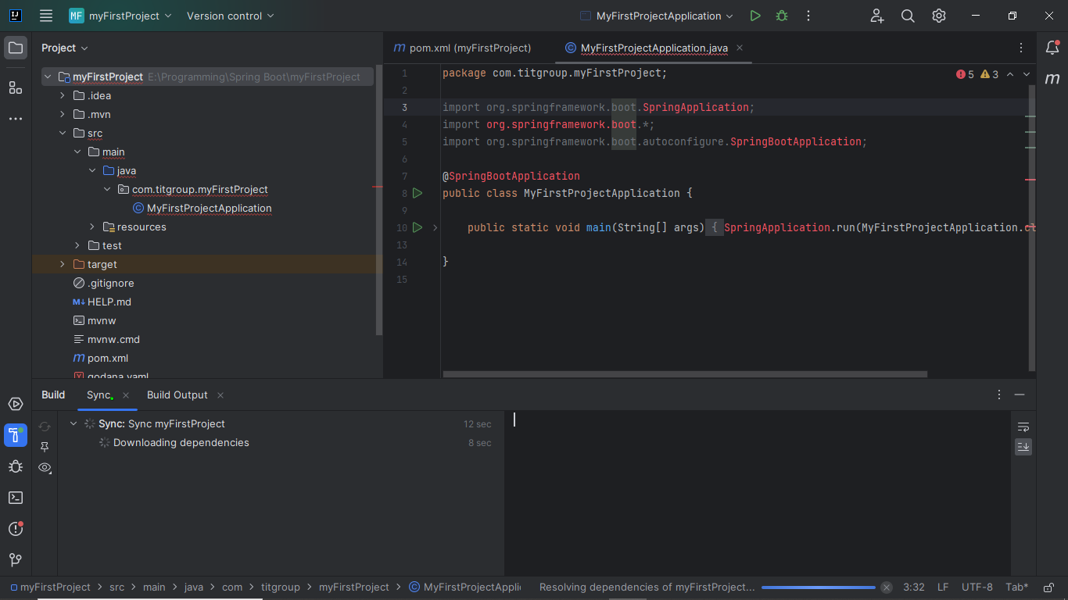

Slide 7
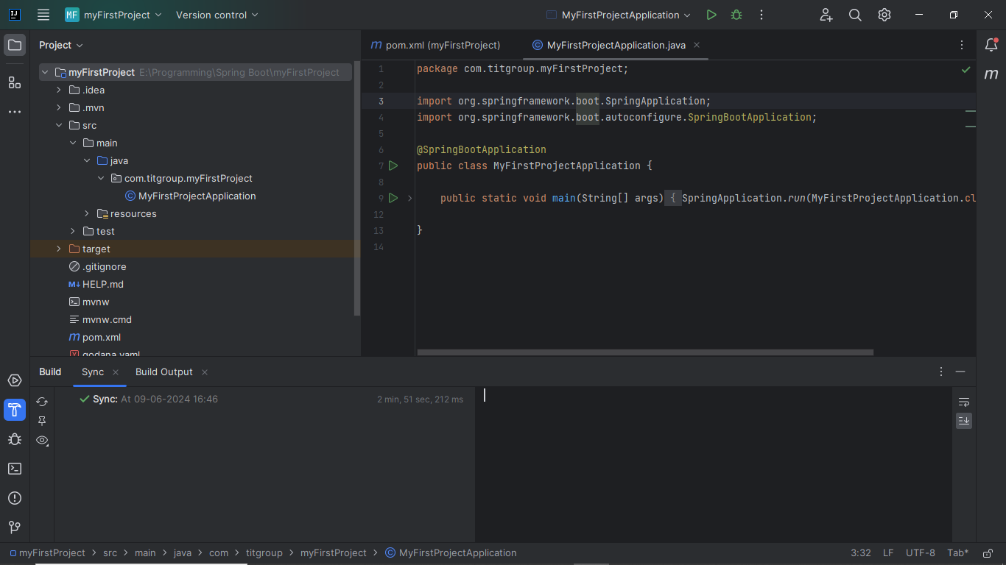

Slide 8
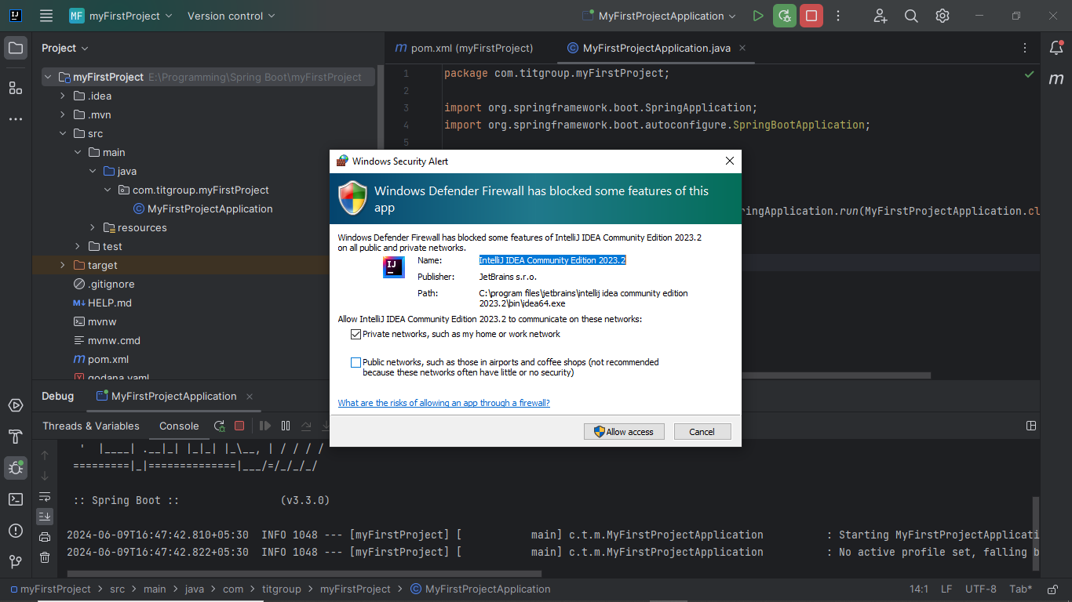

Slide 9
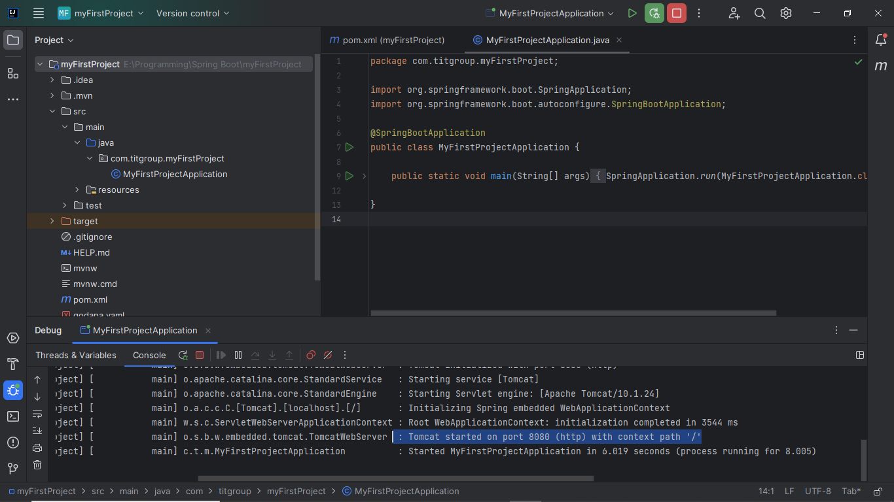

Slide 10
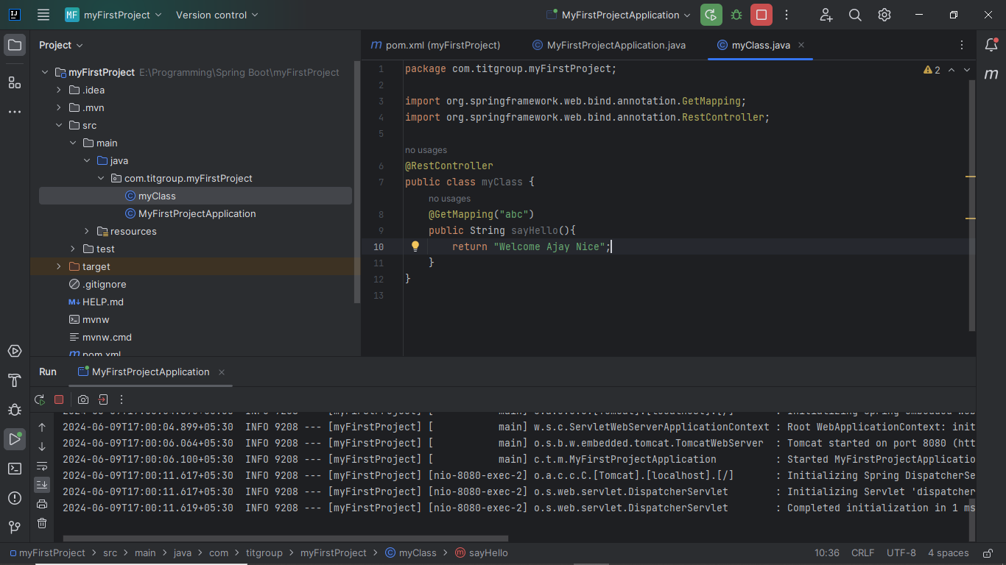

Slide 11

Context path mean
localhost:8080/myproject/abc
Without Context Path mean
localhost:8080/abc

Slide 12
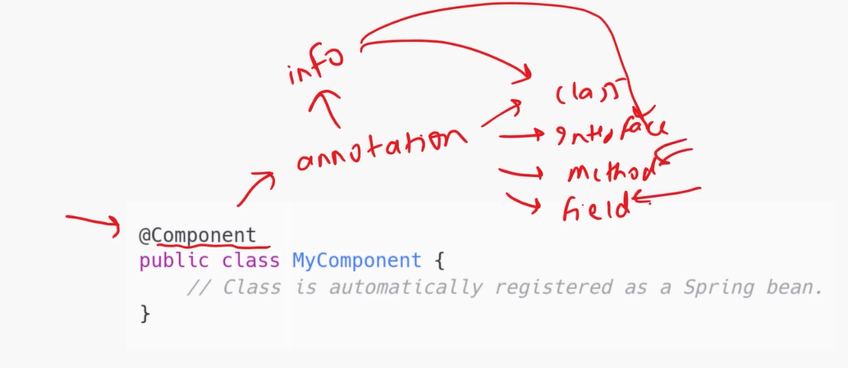
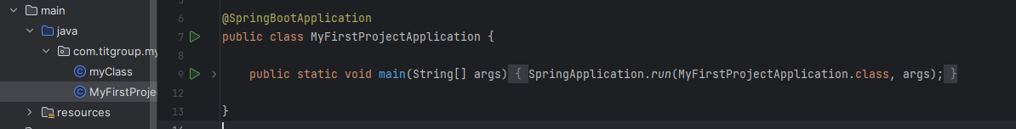
IOC (Inversion of Control)
@SpringBootApplication : Only one this notation will be present in Boot Spring project, above on the main class

Slide 14
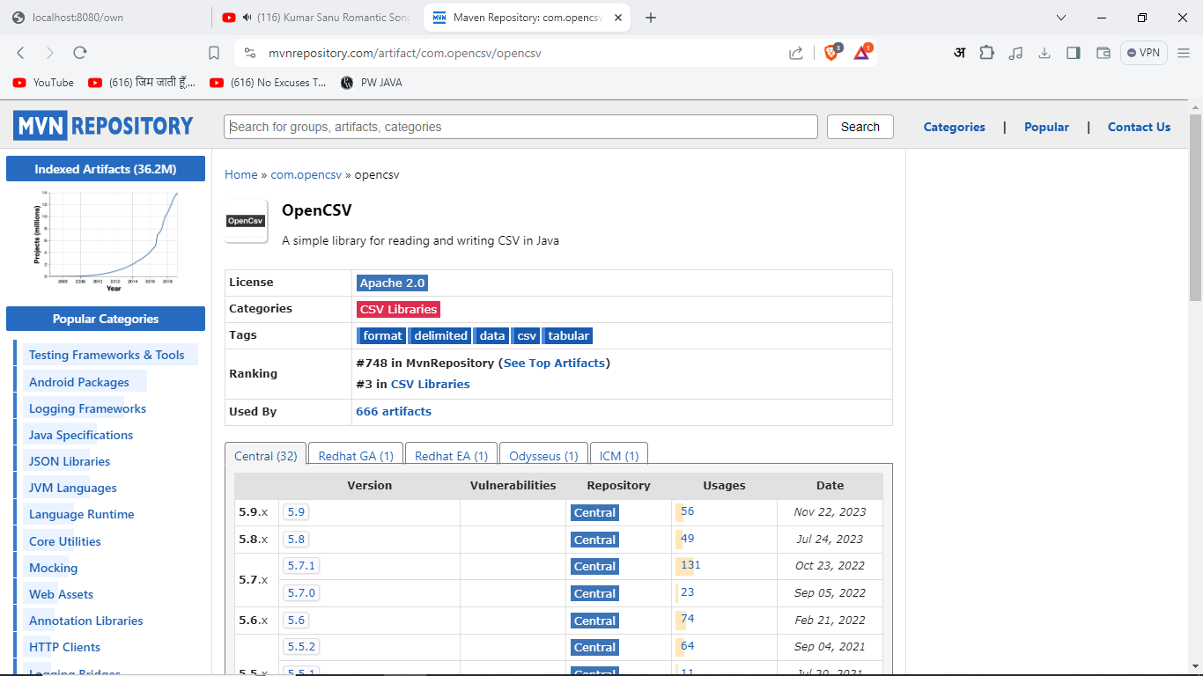

Slide 15
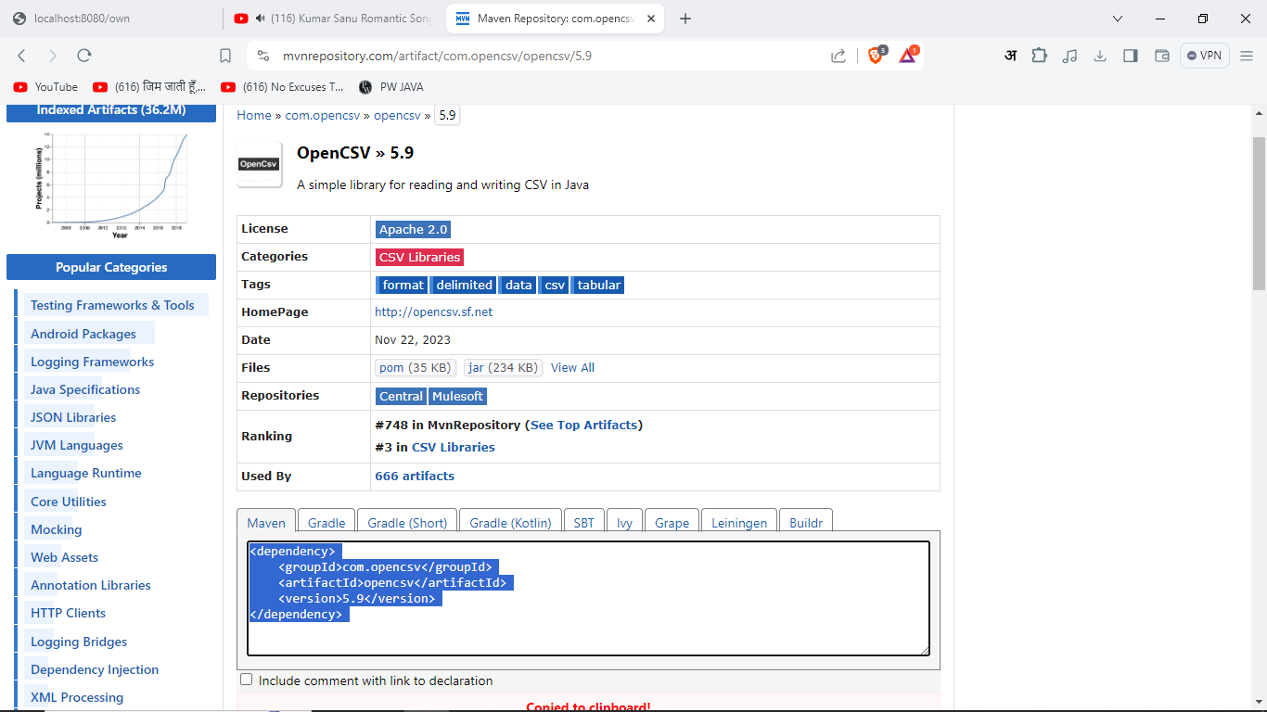

Slide 16
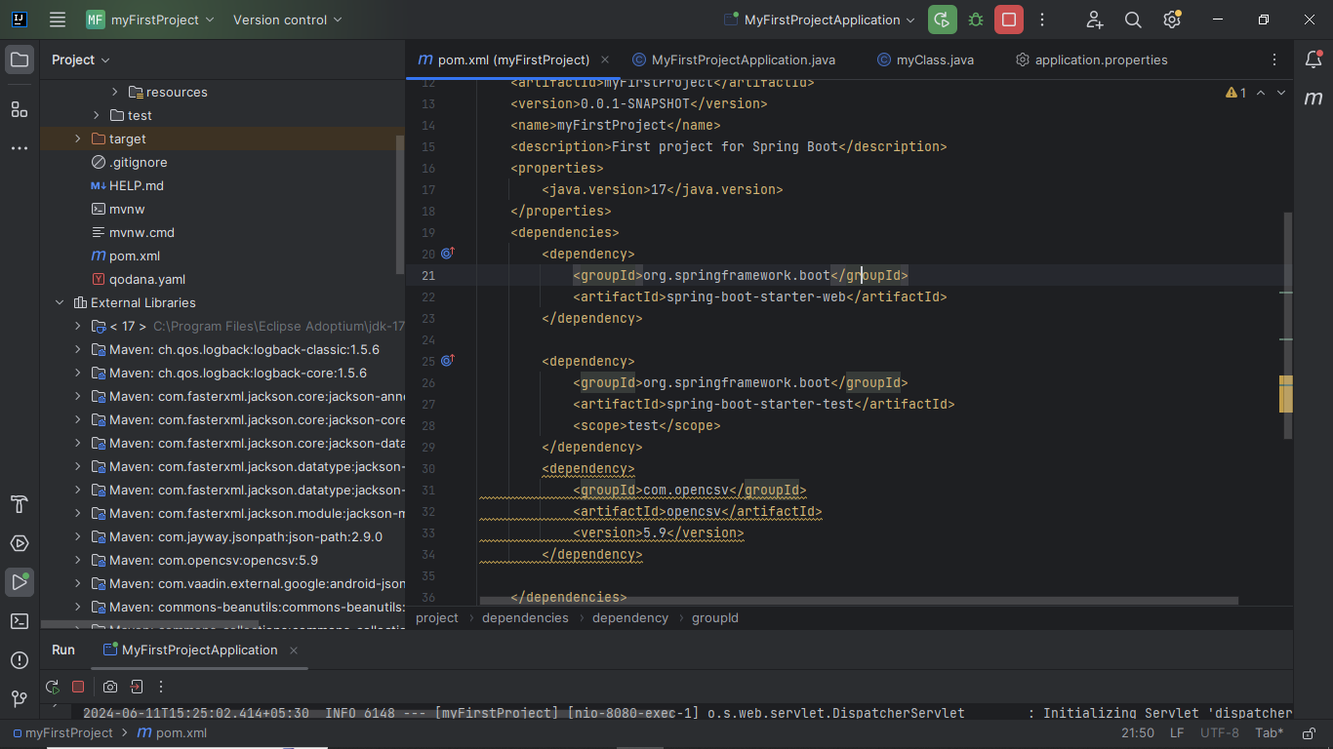

Slide 17
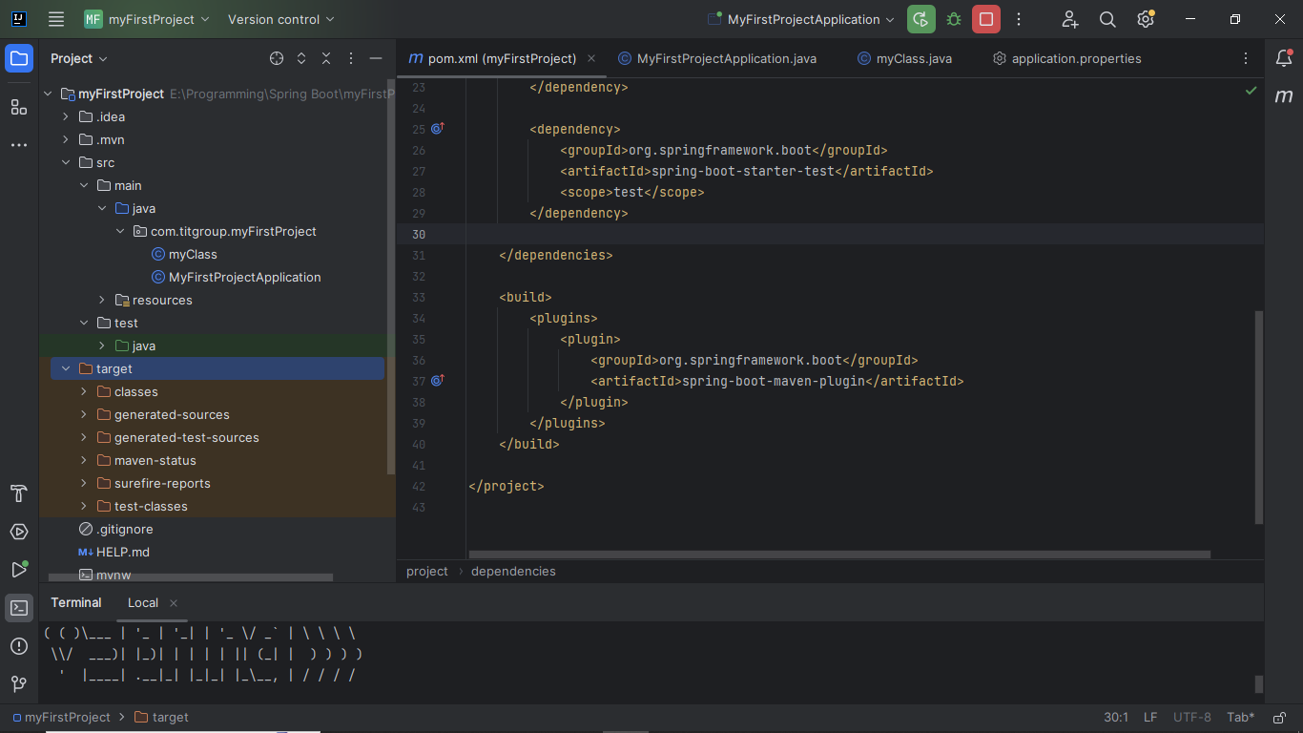
mvn validate
mvn compile
mvn test
mvn package

Slide 18
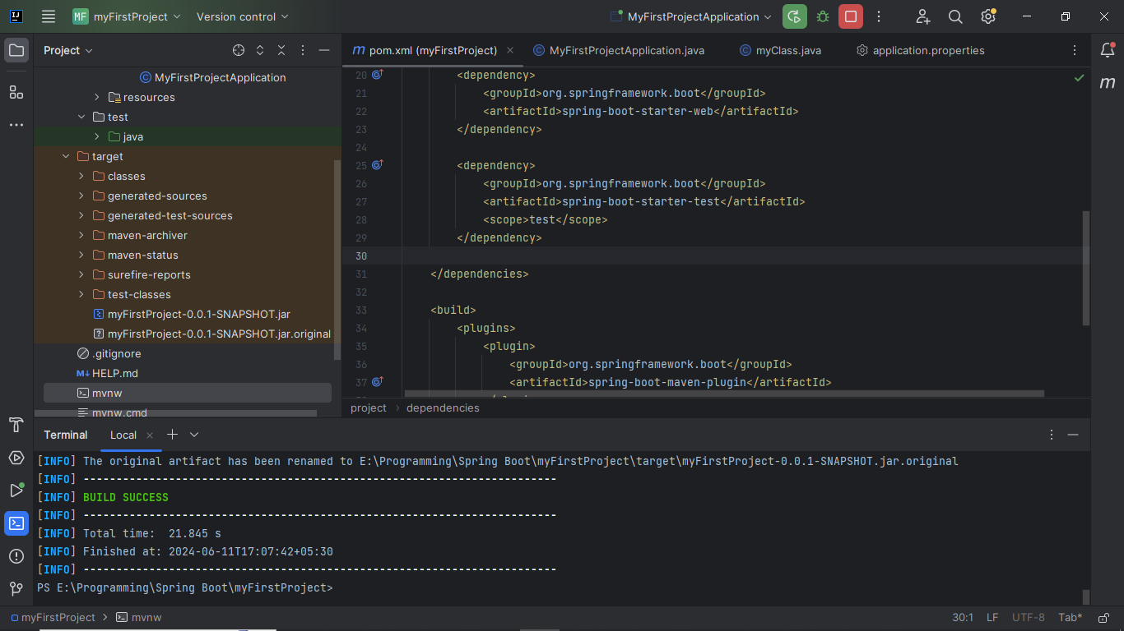
mvn package

Slide 19
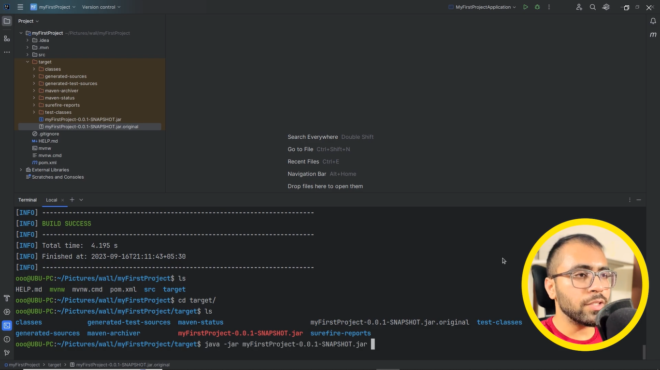
mvn package (run, convert into JAR, Validate, Test)
Second way to run spring boot file

Slide 20
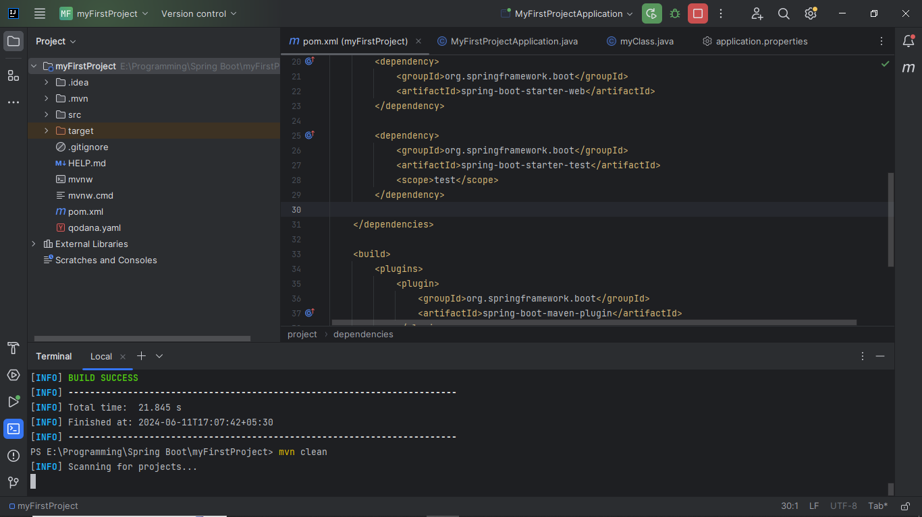
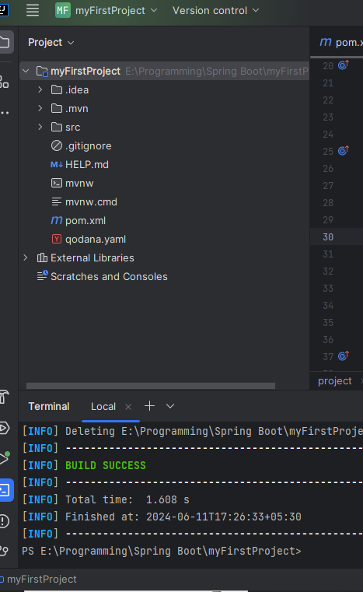
mvn clean : it will be remove target folder

Slide 21
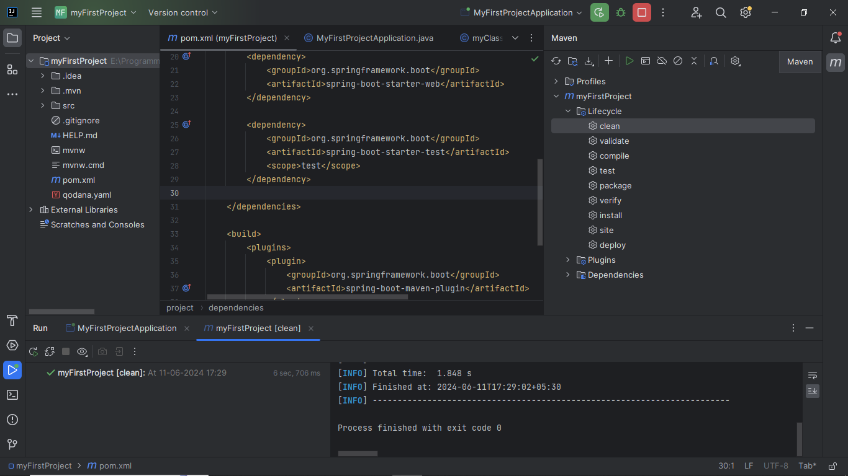
Direct option provide from Intellij Idea mvn validate
mvn compile
mvn test
mvn package

Slide 22
21 July 2024
Path Variable:
Request Variable:

Slide 23
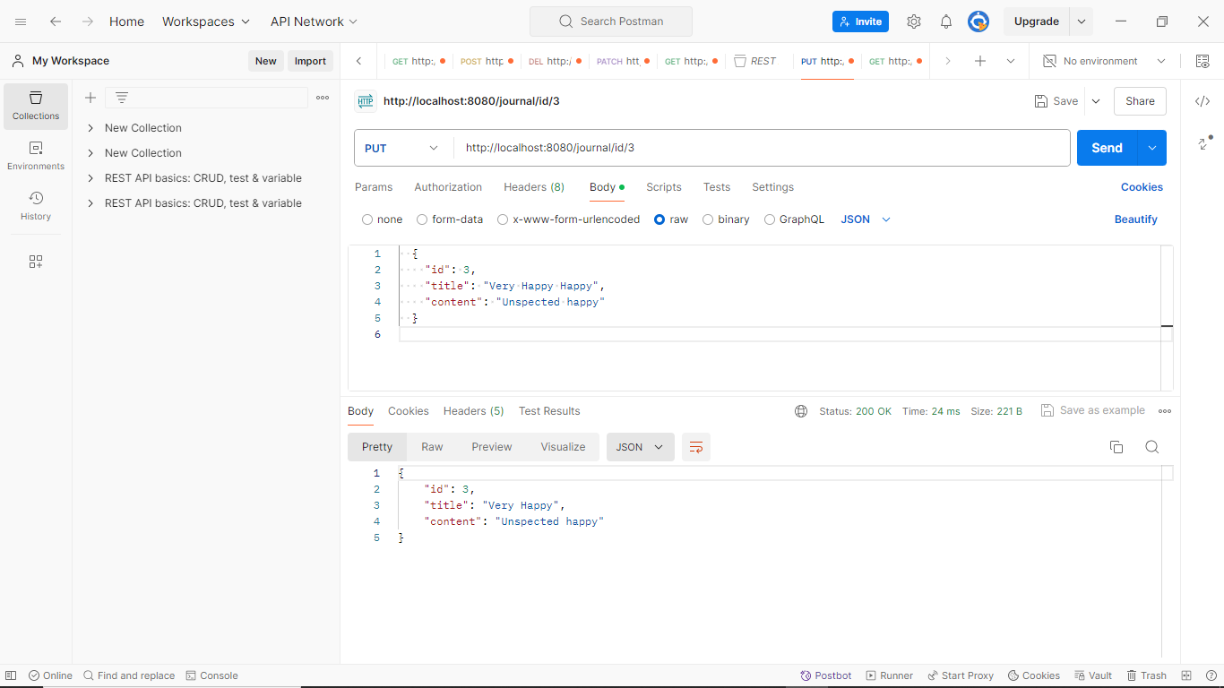
21 July 2024
How to use PUT method

Slide 24
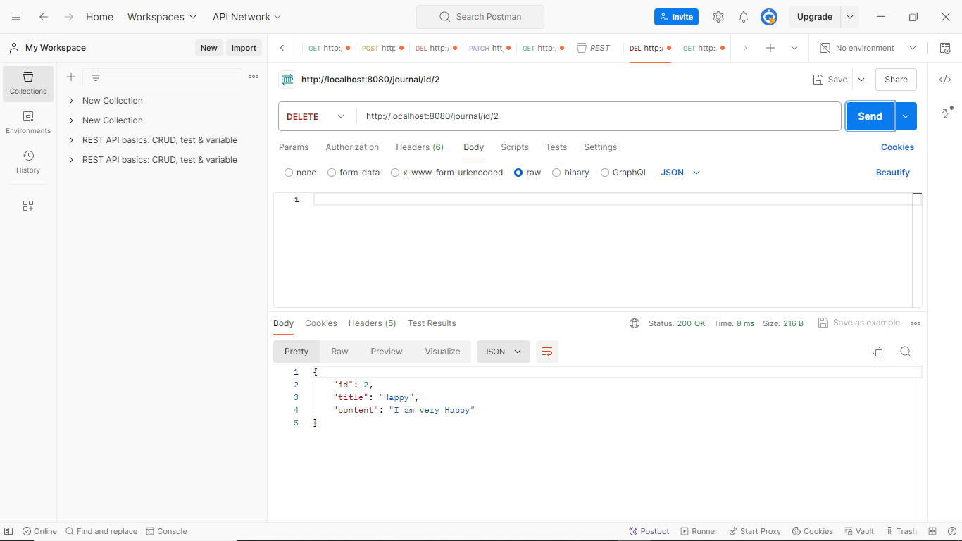
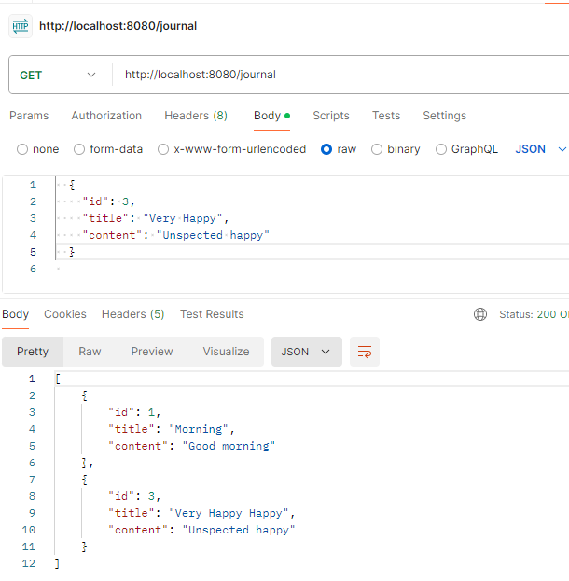
21 July 2024
How to use DELETE method
After delete this id no 2. then remove successfully

Slide 25
